Slide 1
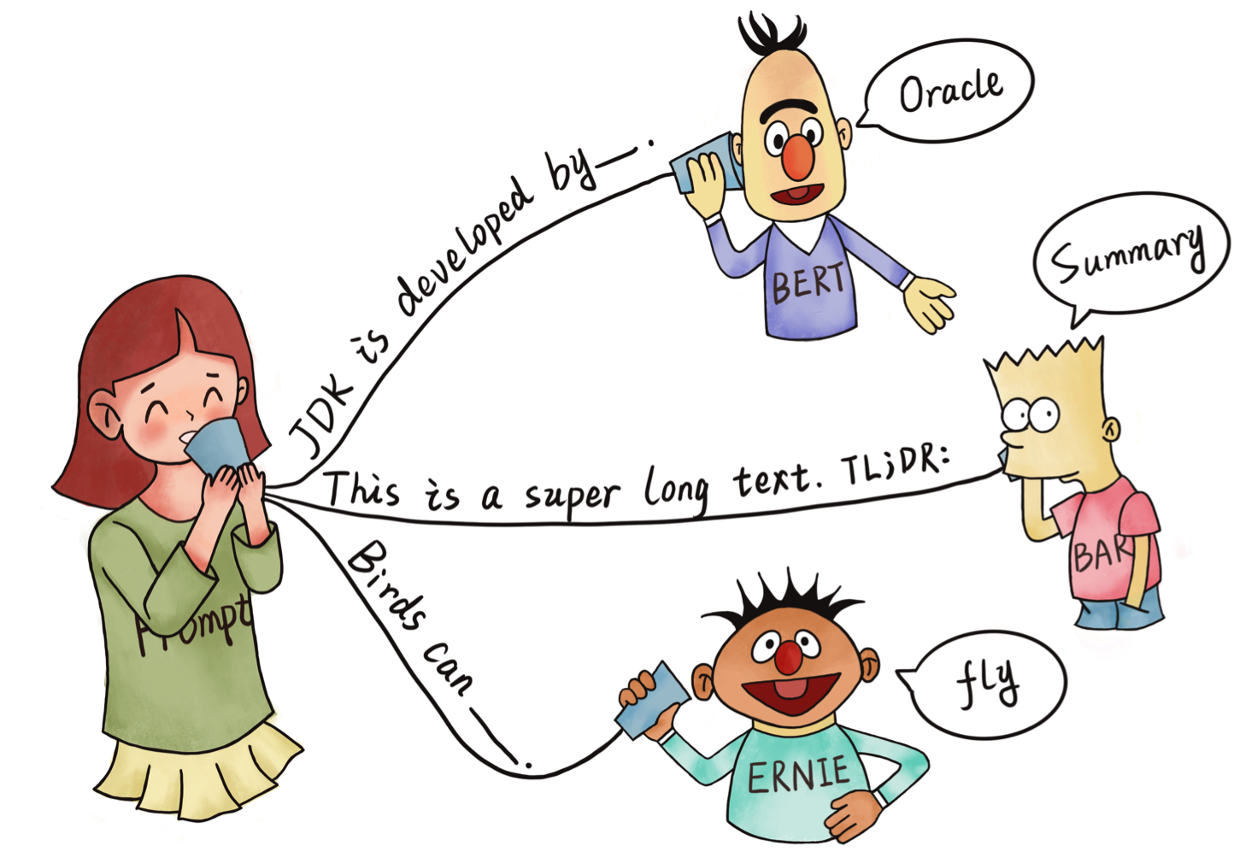
Pre-train, Prompt, and Predict: A Systematic Survey of Prompting Methods in Natural Language Processing
Pengfei Liu, Weizhe Yuan, Jinlan Fu, Zhengbao Jiang, Hiroaki Hayashi, Graham Neubig
Time: 2021-12-18
Reporter: Xiachong Feng

Slide 2

Background

Slide 3

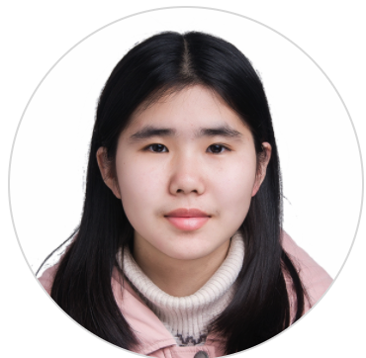
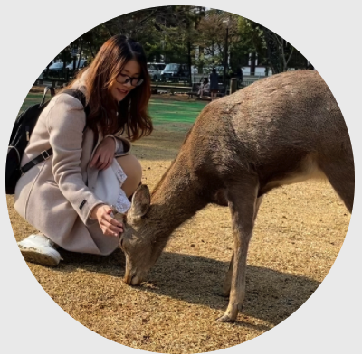

Authors
Handsome Pic
Handsome Pic
Pengfei Liu
Postdoc CMU
PhD Fudan
Weizhe Yuan
PhD Stu CMU
MS CMU
Jinlan Fu
Postdoc NUS
PhD Fudan
Zhengbao Jiang
PhD Stu CMU
Hiroaki Hayashi
PhD Stu CMU
Graham Neubig
A.P. CMU

Slide 4
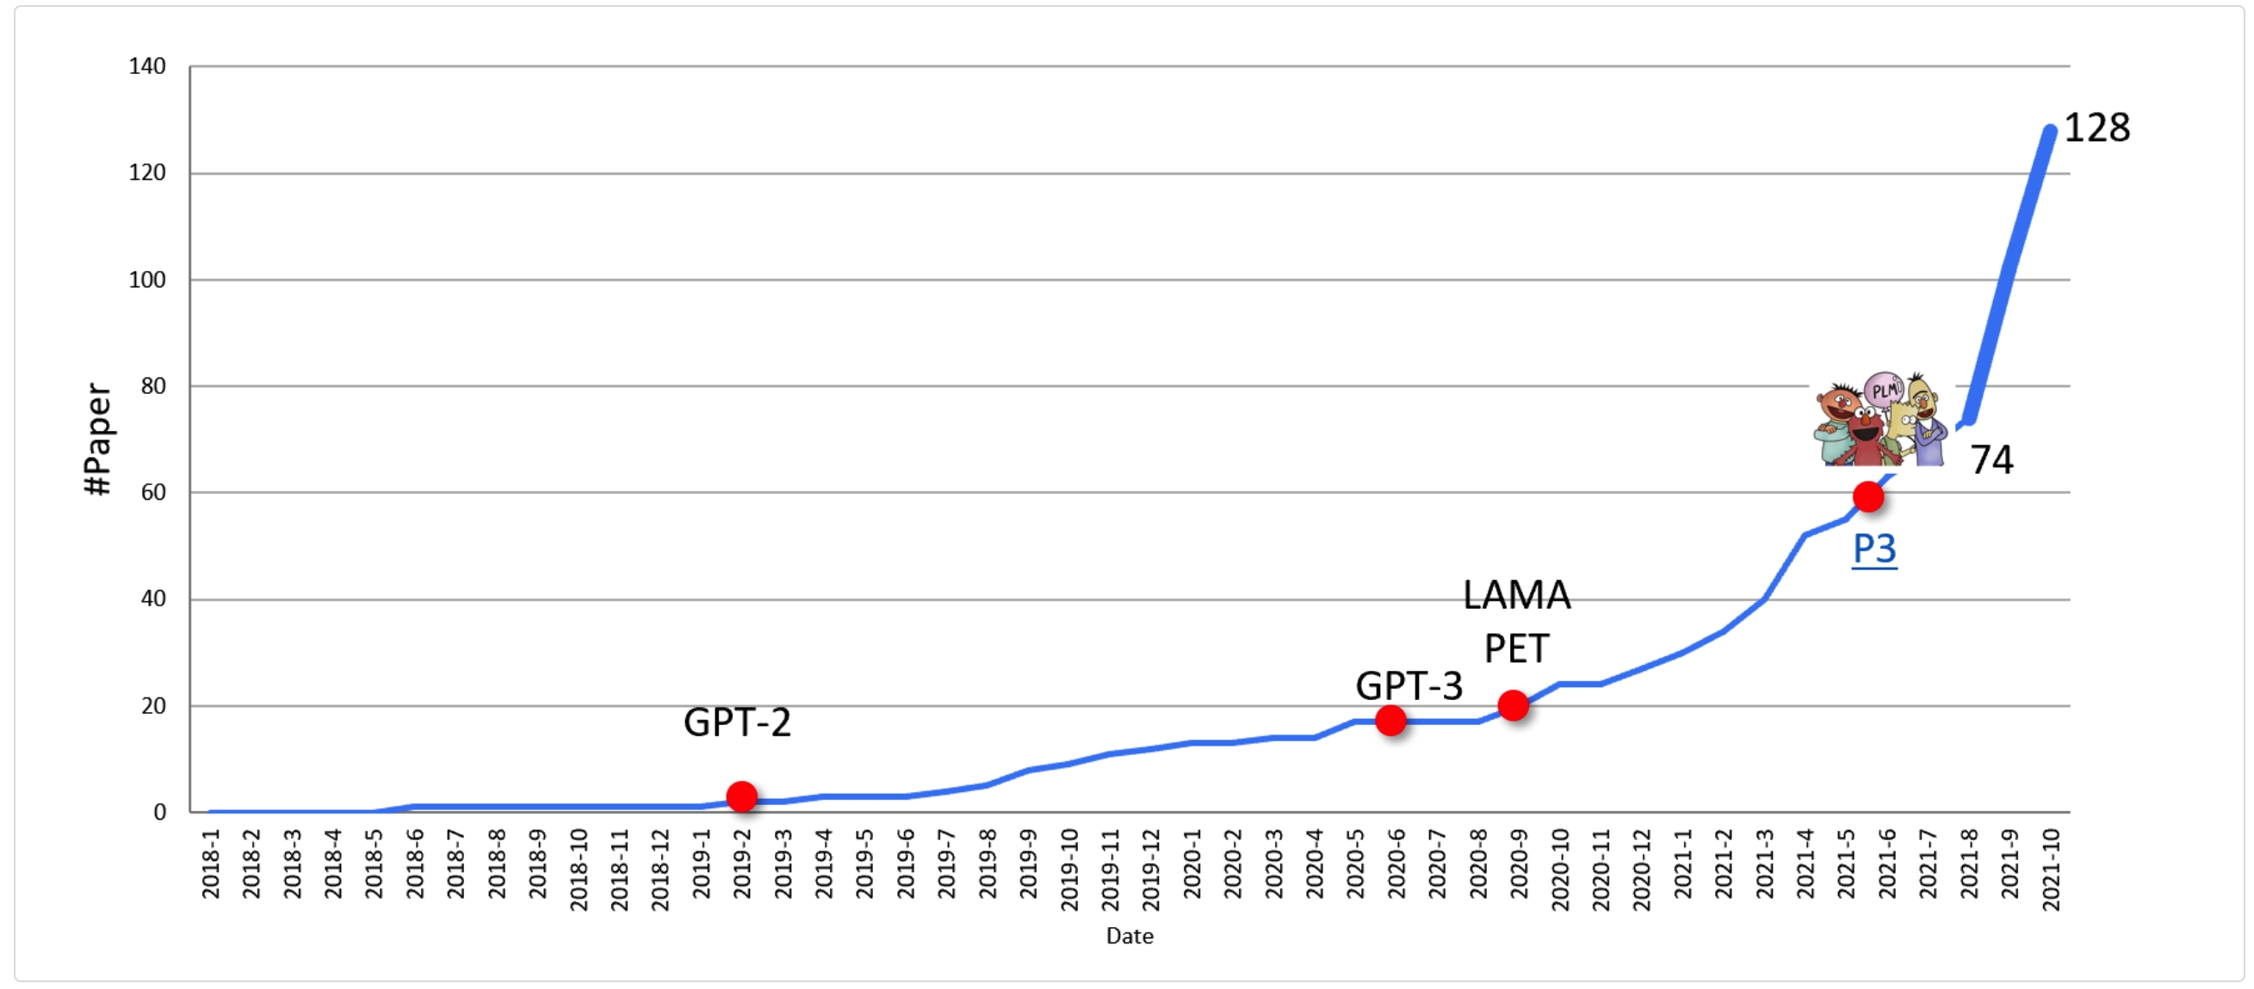
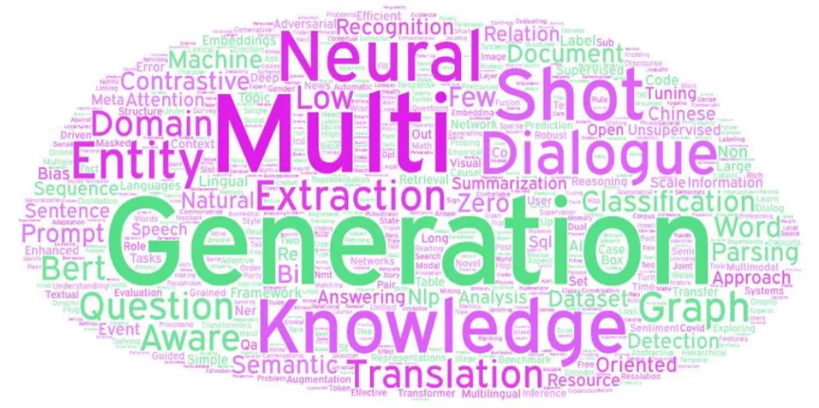
Trending of Prompt-based Papers
http://pretrain.nlpedia.ai/
ARR Nov.

Slide 5
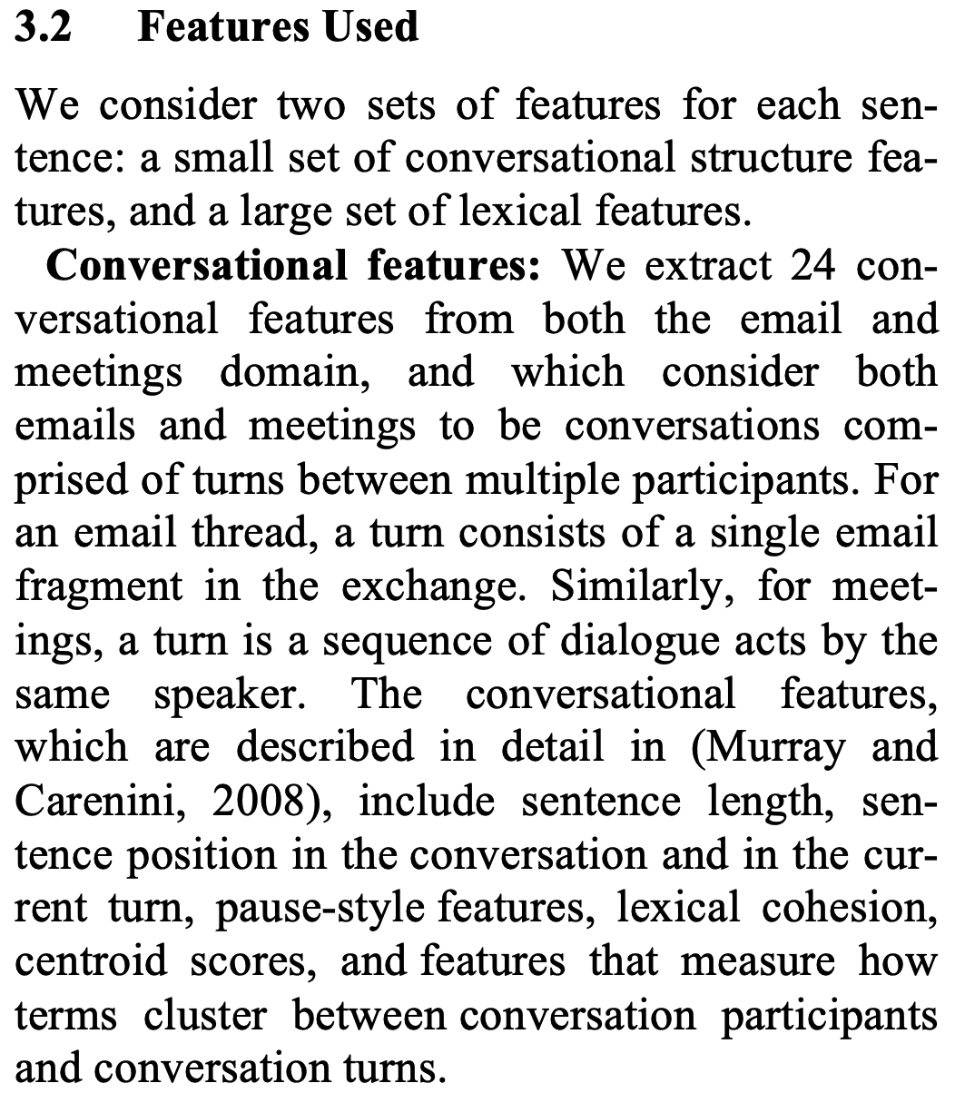
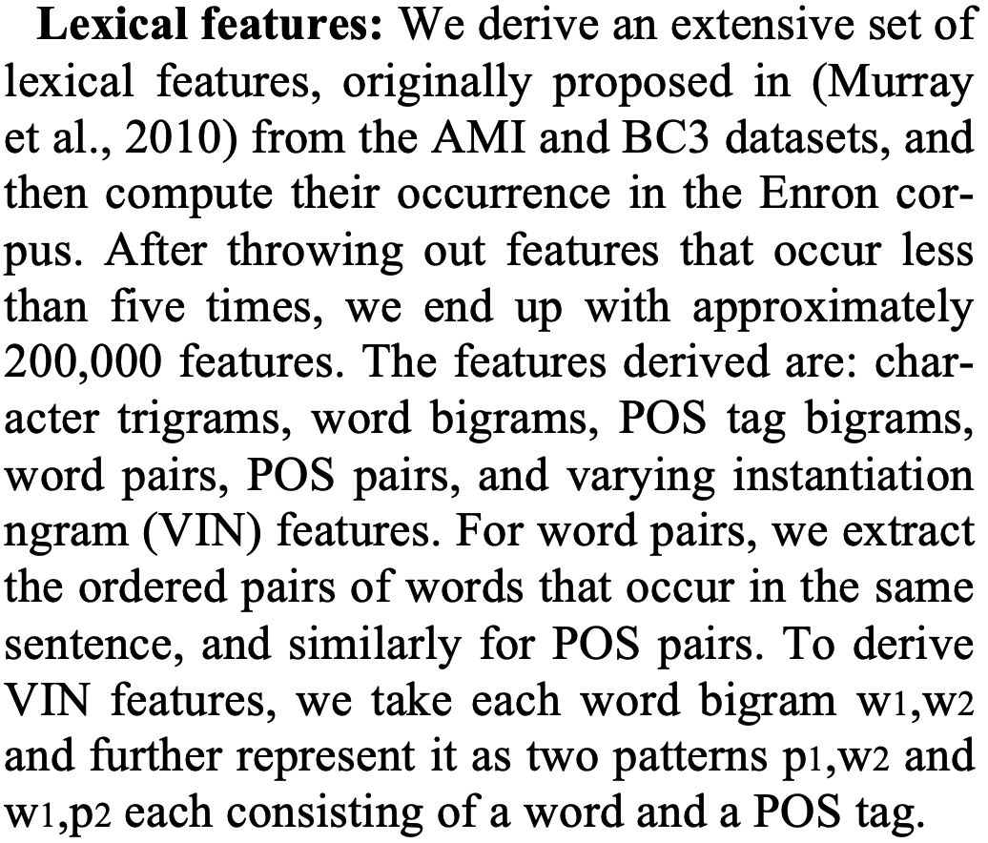
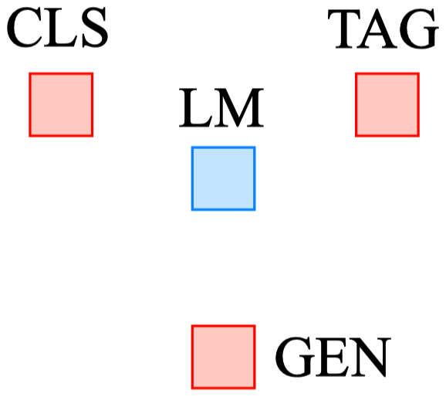
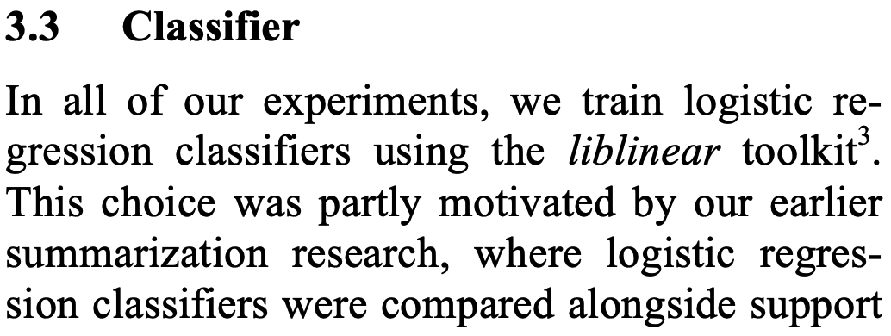
Four Paradigms in NLP
Domain Adaptation to Summarize Human Conversations ACL 2010
Fully Supervised Learning
(Non-Neural Network)
Features Engineering
TF-IDF, POS, Length

Slide 6
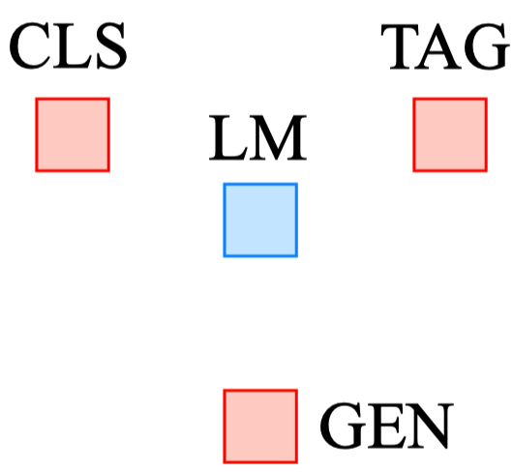
Four Paradigms in NLP
Fully Supervised Learning
(Neural Network)
Architecture Engineering
Conv, RNN, Self-Atten
Fully Supervised Learning
(Non-Neural Network)
Features Engineering
TF-IDF, POS, Length

Slide 7
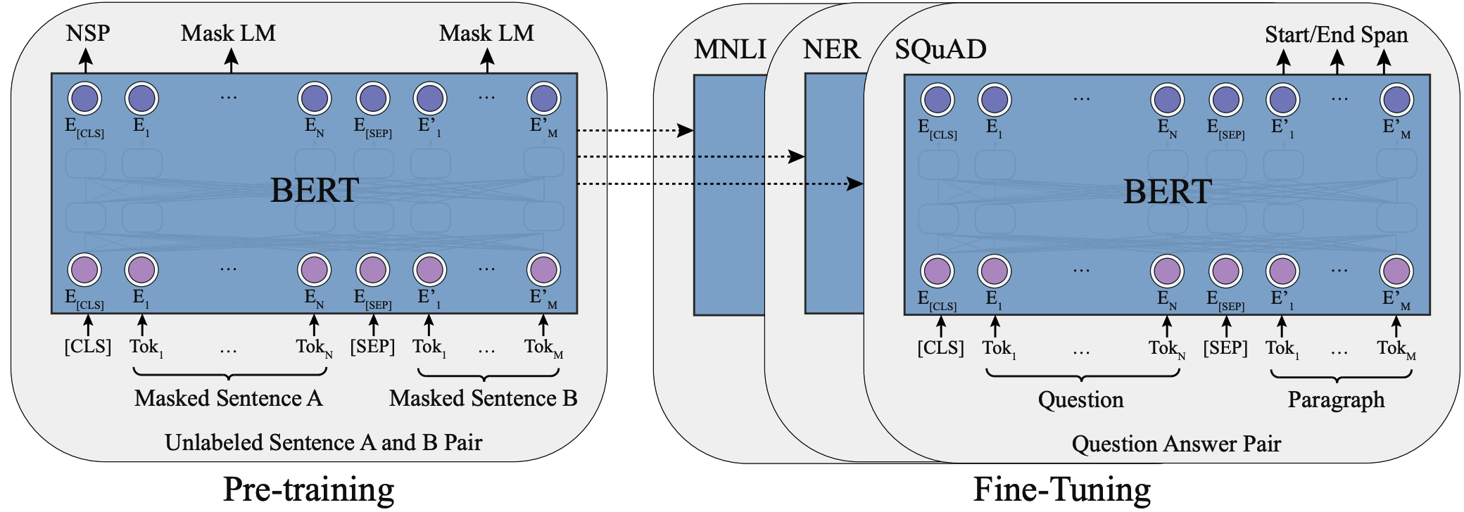
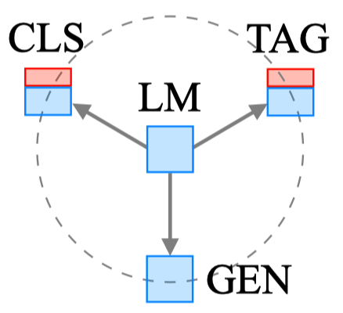
Four Paradigms in NLP
Fully Supervised Learning
(Neural Network)
Architecture Engineering
Conv, RNN, Self-Atten
Fully Supervised Learning
(Non-Neural Network)
Features Engineering
TF-IDF, POS, Length
Pre-train, Fine-tune
Objective Engineering
MLM, NSP

Slide 8
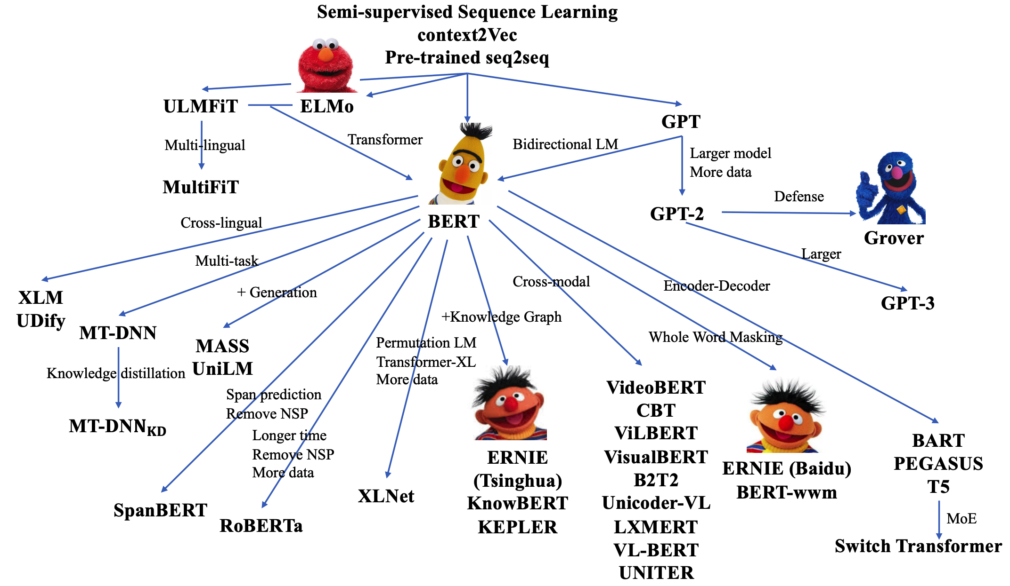
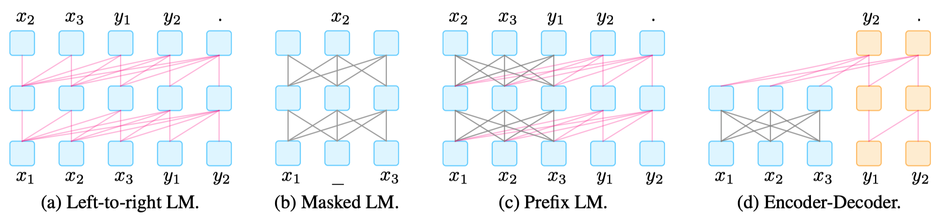
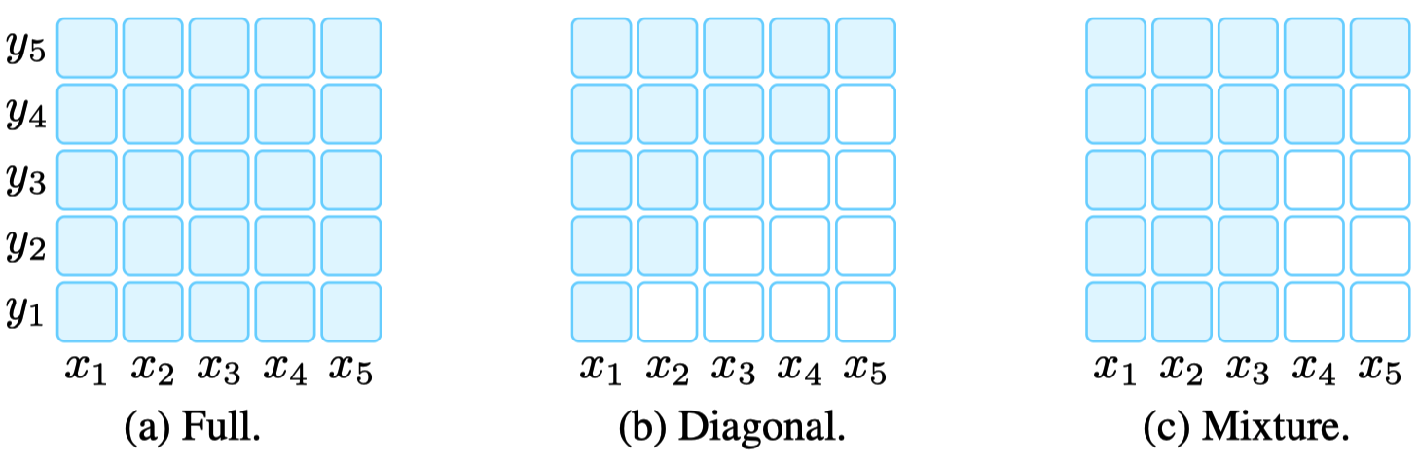
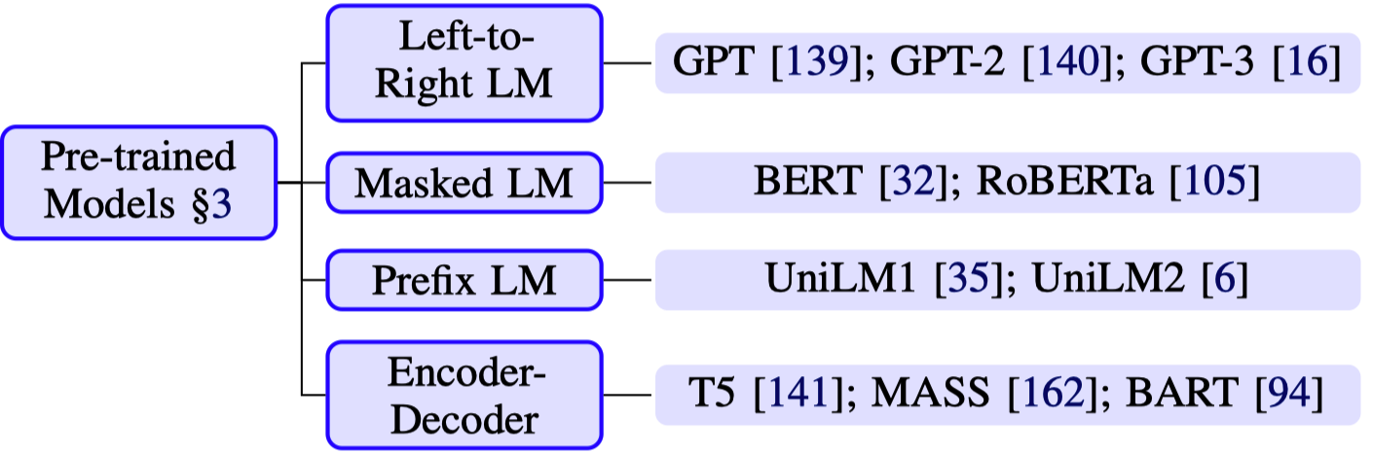
PLMs
Typical paradigms of pre-trained LMs
PLMs
Attention mask patterns

Slide 9
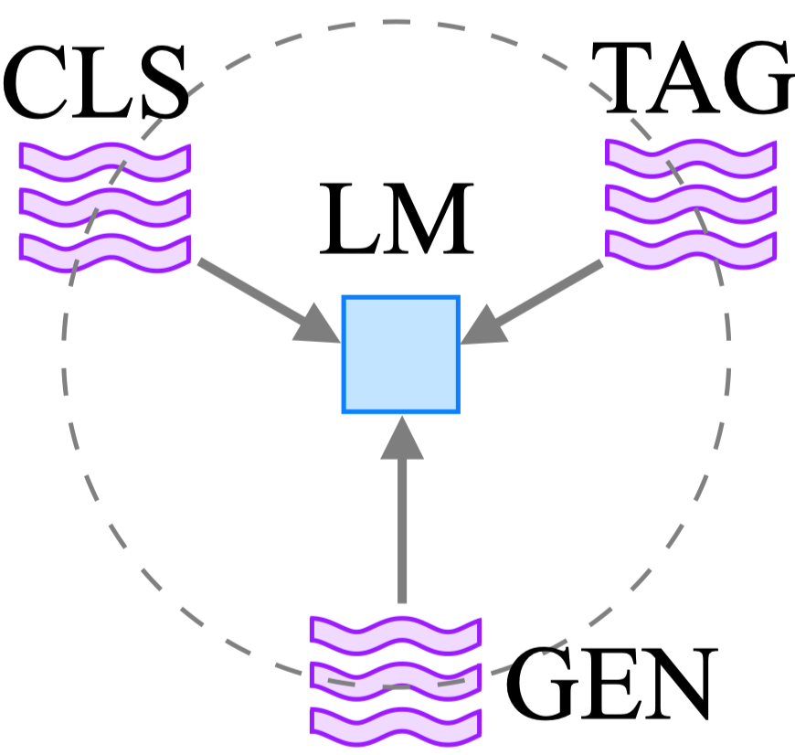
Four Paradigms in NLP
Fully Supervised Learning
(Neural Network)
Architecture Engineering
Conv, RNN, Self-Atten
Pre-train, Prompt, Predict
Prompt Engineering
Fully Supervised Learning
(Non-Neural Network)
Features Engineering
TF-IDF, POS, Length
Pre-train, Fine-tune
Objective Engineering
MLM, NSP

Slide 10
Four Paradigms in NLP
Pre-train, Fine-tune
Objective Engineering
MLM, NSP
Pre-train, Prompt, Predict
Prompt Engineering

Slide 11

Prompt Learning

Slide 12
Naïve Prompt Learning
great
terrible
Label: positive
Label: negative √
Sentiment Classification
MLM head
[CLS] No reason to watch . It was [MASK] . [SEP]

Slide 13
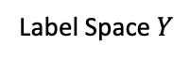
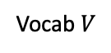
Two Gaps
Pre-train and Fine-tune Paradigm
...
great
terrible
...
CLS head
Label: positive
Label: negative √
MLM head
CLS head
MLM head
Vocab $V$
Label Space $Y$
[CLS] it’s a [MASK] movie in every regard, and [MASK] painful to watch . [SEP]
[CLS] No reason to watch . [SEP]
[CLS] it’s a [MASK] movie in every regard, and [MASK] painful to watch . [SEP]
[CLS] No reason to watch . [SEP]
(a) MLM pre-training
(b) Fine-tuning
Two Gaps

Slide 14
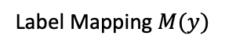
Why Prompt Learning?
Pre-train and Fine-tune Paradigm
...
Label: positive
Label: negative √
great
terrible
Label: positive
Label: negative √
great
terrible
CLS head
MLM head
CLS head
MLM head
...
Vocab $V$
Label Space $Y$
[CLS] it’s a [MASK] movie in every regard, and [MASK] painful to watch . [SEP]
[CLS] No reason to watch . [SEP]
[CLS] it’s a [MASK] movie in every regard, and [MASK] painful to watch . [SEP]
[CLS] No reason to watch . [SEP]
(a) MLM pre-training
(b) Fine-tuning
Prompt Tuning
(
)
(
)
Label Mapping $M(y)$
[CLS] No reason to watch . It was [MASK] . [SEP]

Slide 15
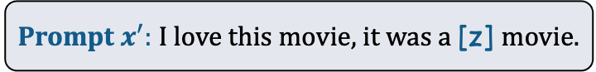
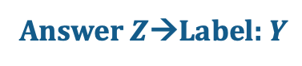
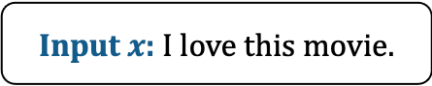
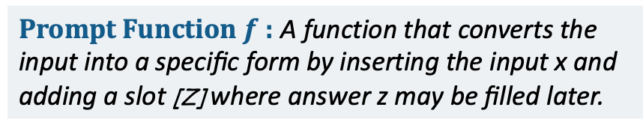
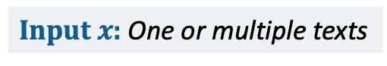
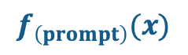
Notation of Prompt Learning
Answer $Z$→Label: $Y$
Good: Positive
Bad: Negative
Answer Mapping
Answer: A token, phrase, or sentence that ﬁlls [Z]
Answer
Filled Prompt: A prompt where slot [Z] is ﬁlled with any answer.
Answered Prompt: A prompt where slot [Z] is ﬁlled with a true answer.
Filled Prompt
I love this movie, it was a bad movie.
Answered Prompt
I love this movie, it was a good movie.
Prompt $x^{′}:$I love this movie, it was a [z] movie.
Prompt: A text where [X] is instantiated by input x but answer slot [Z] is not.
[x] , it was a [z] movie.
Prompt Function $f$: A function that converts the input into a speciﬁc form by inserting the input x and adding a slot [Z] where answer z may be ﬁlled later.
Prompt Function:
$$f_{\left(prompt\right)}(x)$$
Input $x$: I love this movie.
Input $x$: One or multiple texts

Slide 16
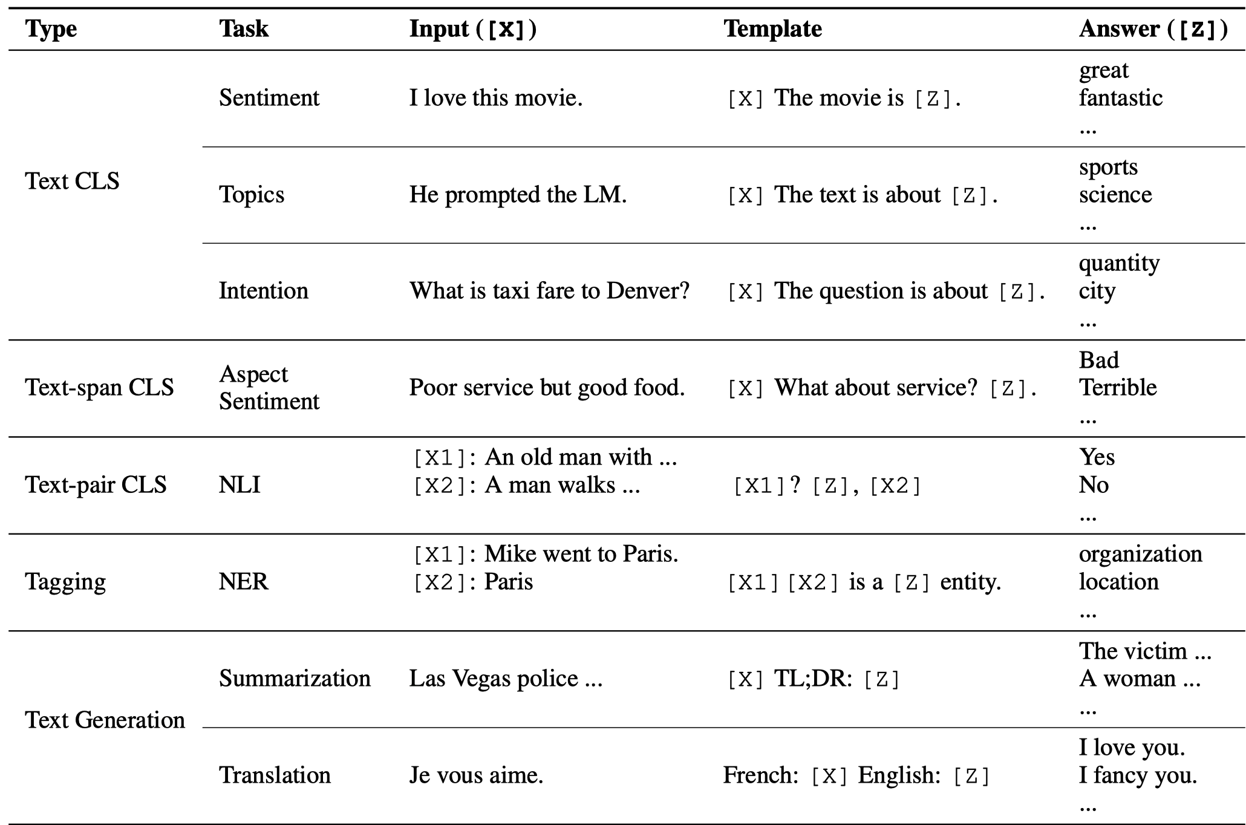
Examples

Slide 17


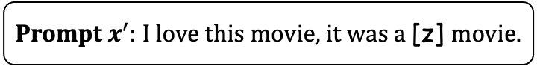
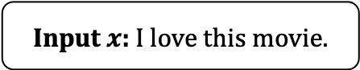
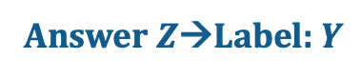
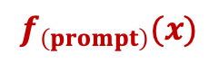
Two Key Components
Answer $Z$→Label: $Y$
Good: Positive
Bad: Negative
Answer
Answer Engineering
Filled Prompt
I love this movie, it was a bad movie.
Answered Prompt
I love this movie, it was a good movie.
Prompt $x^{′}:$I love this movie, it was a [z] movie.
[x] , it was a [z] movie.
Prompt Engineering
Prompt Function:
$$f_{\left(prompt\right)}(x)$$
Input $x$: I love this movie.

Slide 18
Prompt Engineering

Slide 19


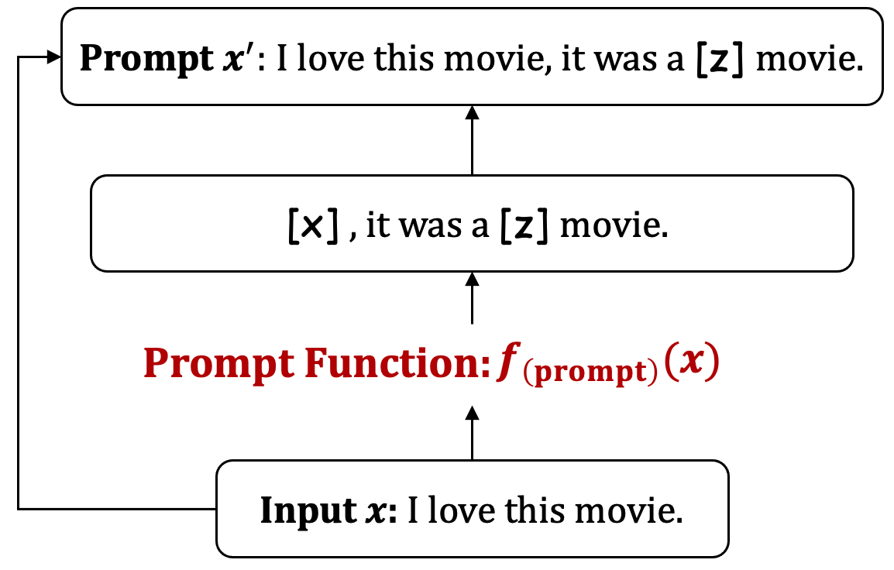

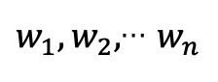
Prompt Engineering
Cloze
This movie is interesting, It’s a [z] movie.
Shape
Prompt Engineering
Prefix
This movie is interesting…., TL,DR, [z]…
Effort
Human
Discrete
$w_{1},w_{2},$… $w_{n}$
Auto
Continuous
Cloze or Prefix?
Human or Auto?
Discrete or Continuous?

Slide 20


Prompt Engineering
Automatically created prompts
Manually created prompts
Mining-based and Paraphrasing-based
How Can We Know What Language Models Know?
GPT Understands, Too
Prompt-tuning
Exploiting Cloze Questions for Few Shot Text Classiﬁcation and Natural Language Inference
Gradient Searching
AUTOPROMPT: Eliciting Knowledge from Language Models with Automatically Generated Prompts
Learning How to Ask: Querying LMs with Mixtures of Soft Prompts
In-context learning
Language Models are Few-Shot Learners (GPT-3)
Factual Probing Is [MASK]: Learning vs. Learning to Recall
Using Separate Model
Making pre-trained language models better few-shot learners.
Differentially Optimized

Slide 21
Answer Engineering

Slide 22
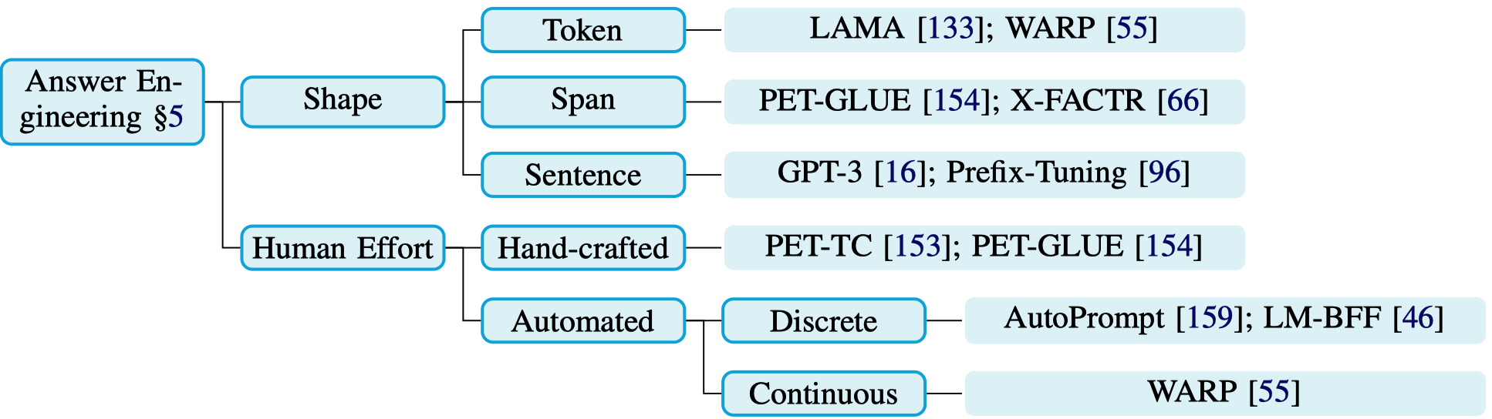

Answer Engineering
Answer $Z$→Label: $Y$
Good: Positive
Bad: Negative
Answer
Filled Prompt
I love this movie, it was a bad movie.
Answered Prompt
I love this movie, it was a good movie.

Slide 23


Papers

Slide 24
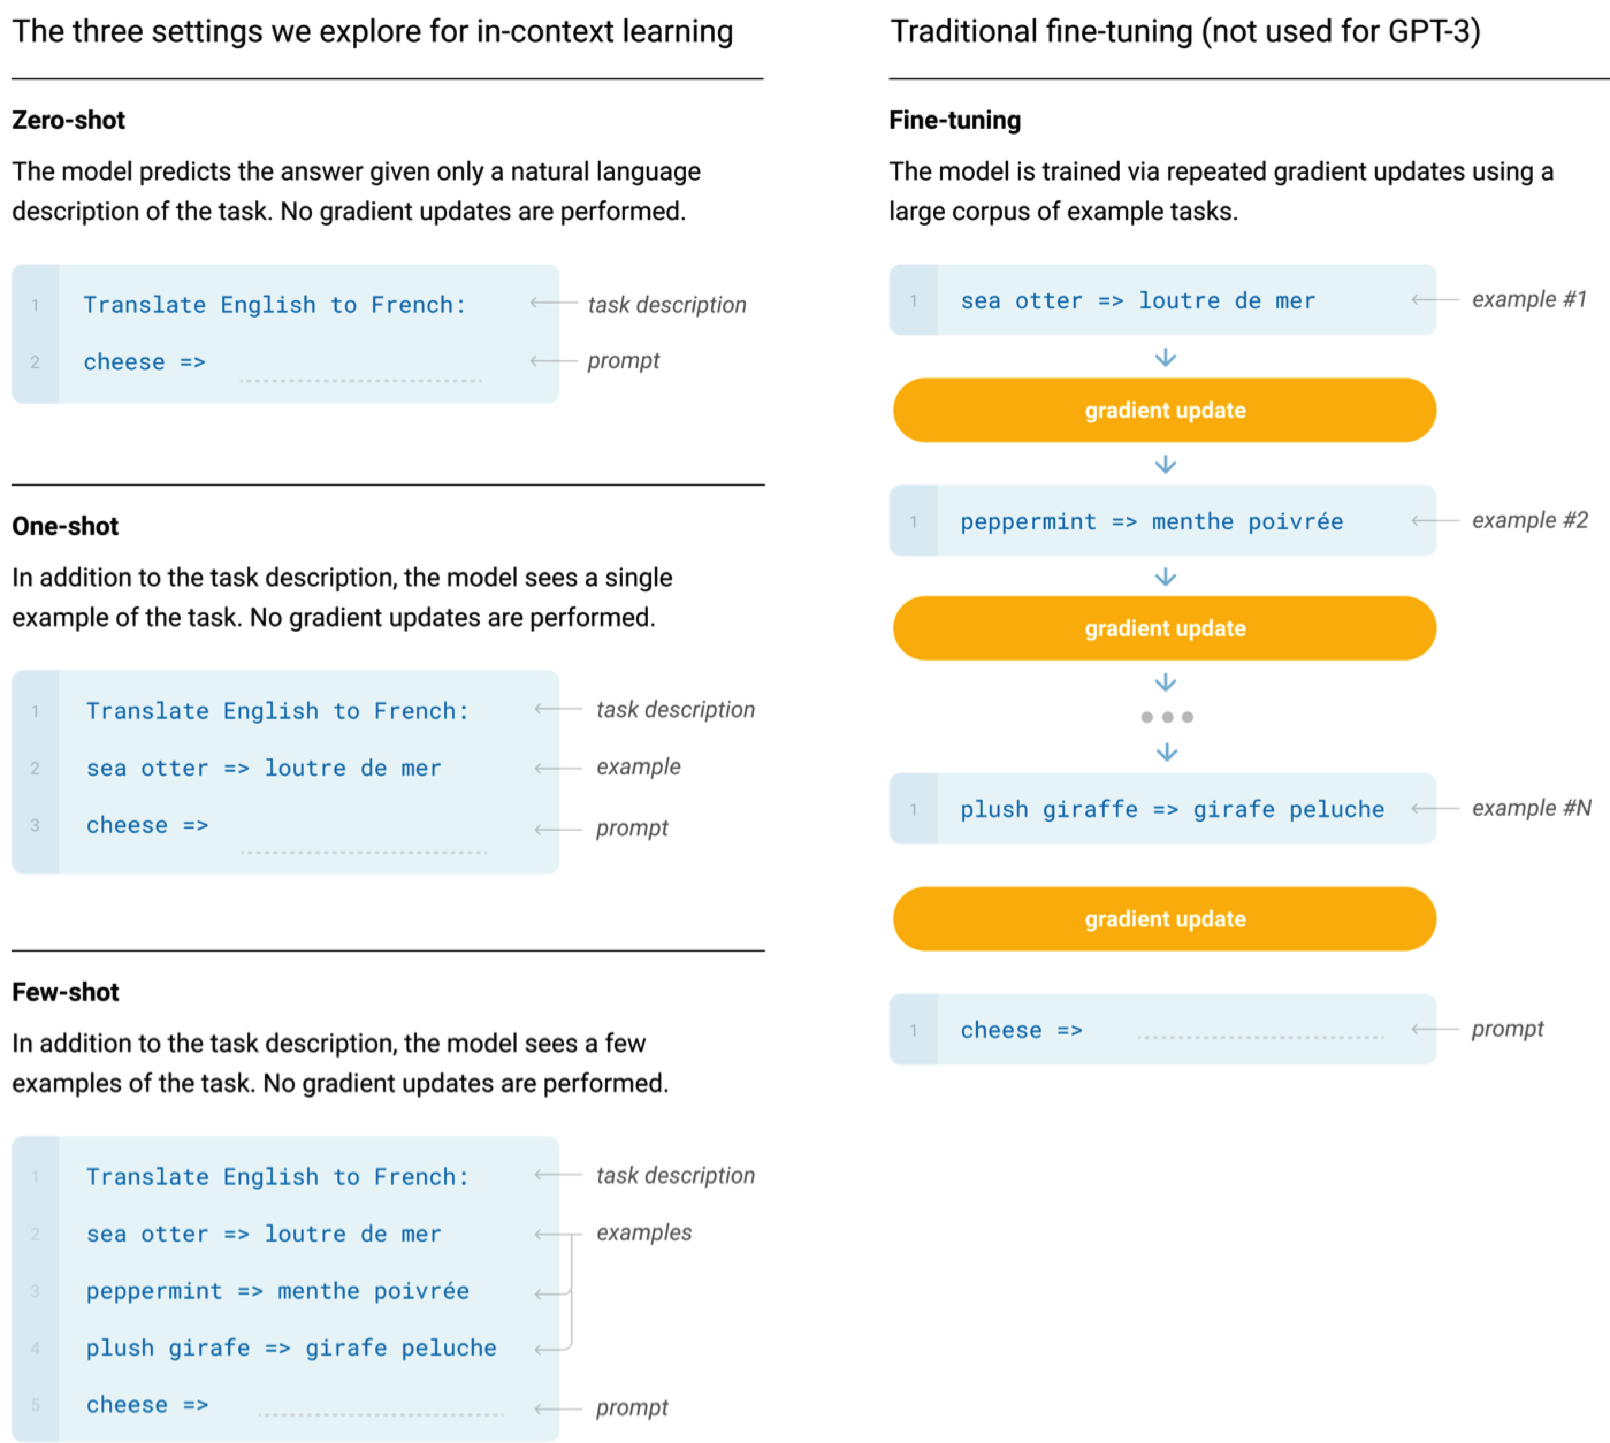
GPT-3
Prompt Engineering
Human + Discrete
Answer Engineering
Token, Span, Sent
Language Models are Few-Shot Learners

Slide 25



Text Classification
Sentiment Classification
great
terrible
Label: positive
Label: negative √
Prompt Engineering
MLM head
Cloze + Human + Discrete
Answer Engineering
[CLS] No reason to watch . It was [MASK] . [SEP]
Token + Human + Discrete
Topic detection
this text is about {“health”, “ﬁnance”, “politics”, “sports”, etc.}
Emotion detection
this text expresses {“anger”, “joy”, “sadness”, “fear”, etc.}
Situation detection
the people there need {“shelter”, “water”, · · · }
Benchmarking Zero-shot Text Classification: Datasets, Evaluation and Entailment Approach, EMNLP 2019
Notes:
Wenpeng Yin, Jamaal Hay, Dan Roth Cognitive Computation Group Department of Computer and Information Science, University of Pennsylvania

Slide 26
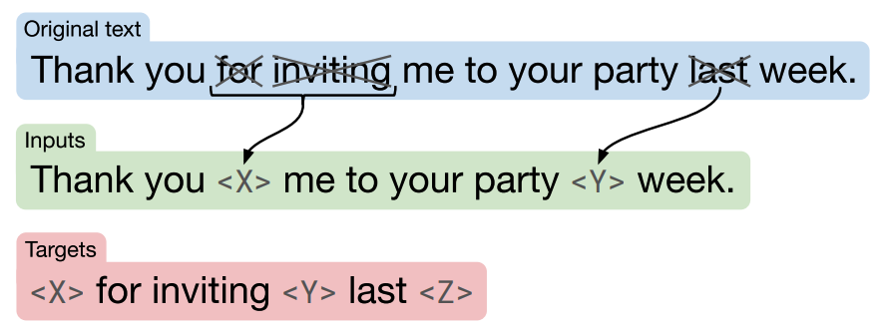
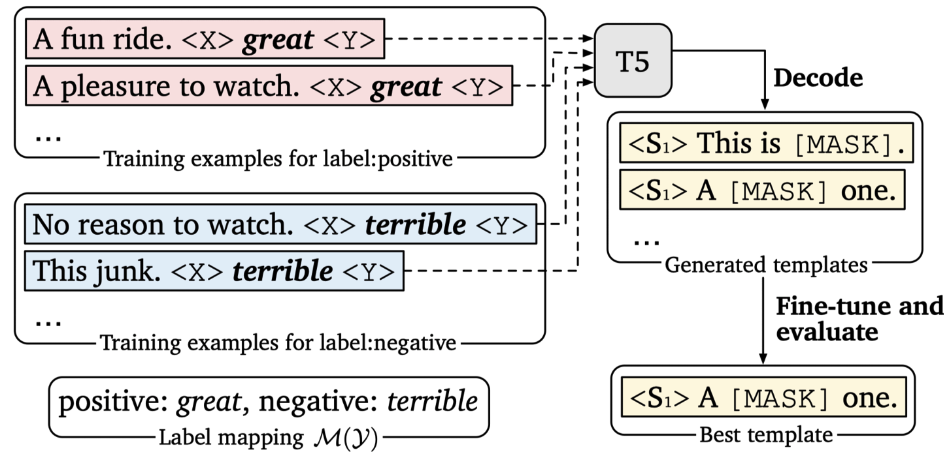
Text Classification: LM-BFF
T5 Objective
LM-BFF: Generate Prompt
Making Pre-trained Language Models Better Few-shot Learners

Slide 27
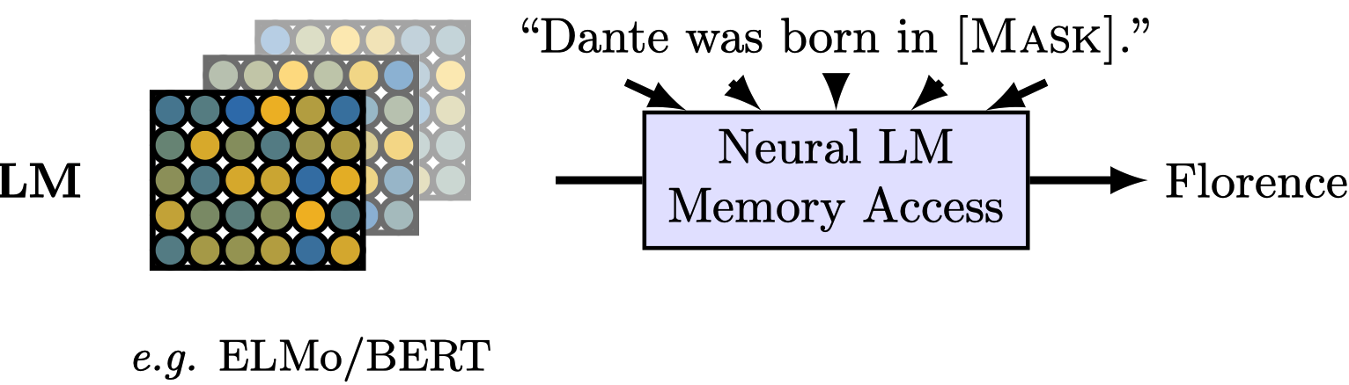
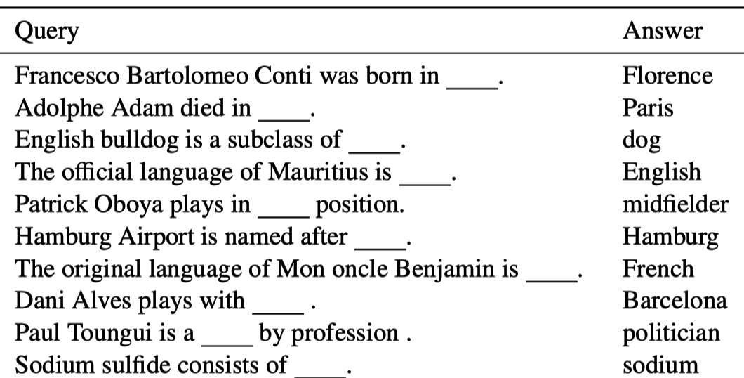
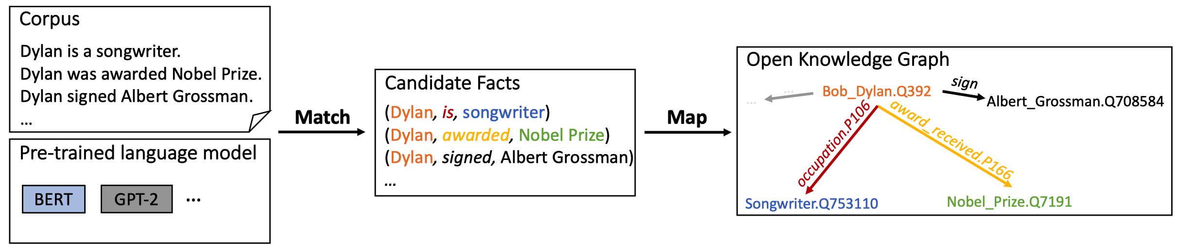
Knowledge Mining
Language Models as Knowledge Bases?
Language Models are Open Knowledge Graphs

Slide 28
Knowledge Mining: P-Tuning
Discrete Prompt Learning
P-tuning
PLMs
(GPT, BERT,…)
PLMs
(GPT, BERT,…)
e(of)
h₀
…
h_{i}
e(cap)
e(Bri)
h_{i+1}
…
h_{m}
e([MASK])
e(The)
e(capital)
e(Britain)
e(is)
e([MASK])
The
capital
of
Britain
is
[MASK]
capital
Britain
[MASK]
Prompt Generator
Prompt Encoder
Discrete
rewards
Back
Propagation
[P₀]
…
[P_{i}]
[P_{i+1}]
…
[P_{m}]
GPT Understands, Too

Slide 29
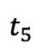
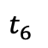
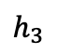
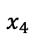
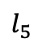
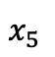
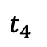
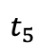
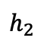
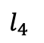























NER
Bangkok
is
a
Location
entity
Training
$$t_{2}$$
$$t_{3}$$
$$t_{4}$$
$$t_{5}$$
$$t_{6}$$
O
O
O
O
O
B-LOC
Encoder
Decoder
$$l_{1}$$
$$l_{2}$$
$$l_{3}$$
$$l_{4}$$
$$l_{5}$$
$$l_{6}$$
$$x_{1}$$
$$x_{2}$$
$$x_{3}$$
$$x_{4}$$
$$x_{5}$$
$$x_{6}$$
$$t_{1}$$
$$t_{2}$$
$$t_{3}$$
$$t_{4}$$
$$t_{5}$$
Softmax/CRF
ACL
will
be
held
in
Bangkok
<s>
Bangkok
is
a
Location
$$h_{1}$$
$$h_{2}$$
$$h_{3}$$
$$h_{4}$$
$$h_{5}$$
$$h_{6}$$
Template:
<s>
〈 candidate_span 〉
is
a
〈 entity_type 〉
entity
Encoder
$$x_{1}$$
$$x_{2}$$
$$x_{3}$$
$$x_{4}$$
$$x_{5}$$
$$x_{6}$$
Bangkok
is
a
Location
entity
(scoring: 0.8)
Testing
ACL
will
be
held
in
Bangkok
Bangkok
is
a
person
entity
(scoring: 0.3)
Sequence Labeling
Bangkok
is
not a
entity
(scoring: 0.1)
ACL
will
be
held
in
Bangkok
Prompt Engineering
ACL will
is
a
Location
entity
(scoring: 0.1)
Cloze + Human + Discrete
ACL
will
be
held
in
Bangkok
ACL will
is
a
person
entity
(scoring: 0.1)
Answer Engineering
ACL
will
be
held
in
Bangkok
entity
Token + Human + Discrete
ACL will
is
not a
(scoring: 0.9)
Template-Based Named Entity Recognition Using BART, Findings of ACL 2021
Notes:
Leyang Cui † 3♥ , Yu Wu ‡ , Jian Liu 3♥ , Sen Yang 3♥ , Yue Zhang 3♥ ∗ † Zhejiang University ‡ Microsoft Research Asia 3 School of Engineering, Westlake University ♥ Institute of Advanced Technology, Westlake Institute of Advanced Study {cuileyang,liujian,yangsen,zhangyue}@westlake.edu.cn Wu.Yu@microsoft.com

Slide 30




Relation Extraction
Prompt Engineering
MLM HEAD
1024 x 30000
Cloze + Auto + Continuous
Relation Embedding Head
Answer Engineering
1024 x 30005
Token + Auto + Continuous
[sub]
[obj]
[obj]
Apple [MASK] Steve Jobs [SEP]
[sub]
[CLS] [E₂] Steve Jobs [/E₂], co-founder of [E₁] Apple [/E₁] [SEP]
Entity
Knowledge
Injection
organization
organization
Relation
Knowledge
Injection
per : countries_of_residence
Person
knowledge embedding (KE)
[sub]
[obj]
Relation Embedding Head
||
+
-
||
[sub]
[obj]
REL
person
date
person
date
countries
residence
KnowPrompt: Knowledge-aware Prompt-tuning with Synergistic Optimization for Relation Extraction

Slide 31


Text Generation
Fine-tuning
Summary
Prompt Engineering
Prefix+ Auto + Continuous
Encoder
Decoder
Answer Engineering
Sent + Discrete
Document
Prefix-tuning
Summary
Summary
Prefix
Encoder
Prefix
Decoder
Prefix
Decoder
Document
Document
Prefix-Tuning: Optimizing Continuous Prompts for Generation, ACL 2021

Slide 32




Cross-modal
...
watching
riding
...
MLM head
Vocab $V$
[IMG]
...
[CLS]
A
woman
is
[MASK]
the
horse
[SEP]
(a) pre-training
...
Label: positive
Label: negative
...
...
...
CLS head
Label $Y$
[IMG]
...
[CLS]
The
horse
watched
by
the
woman
[SEP]
(b) fine-tuning
CPT: Colorful Prompt Tuning for Pre-trained Vision-Language Models

Slide 33

Cross-modal
How to distinguish these two horses in the vocab?
...
word1
word2
...
MLM head
Vocab $V$
...
[IMG]
[CLS]
The
horse
watched
by
the
woman
[MASK]
[SEP]
Image Regions
Query Text
Query Template
(c) Cross-modal Prompt Tuning
CPT: Colorful Prompt Tuning for Pre-trained Vision-Language Models

Slide 34

Cross-modal
By color!
Colorful
Prompt
Tuning
...
red
blue
...
MLM head
Vocab $V$
[IMG]
[CLS]
The
horse
watched
by
the
woman
is
in
[MASK]
color
[SEP]
Image Regions
Query Text
Query Template
CPT: Colorful Prompt Tuning for Pre-trained Vision-Language Models

Slide 35



Part Conclusion
Prompt
PLMs
Downstream Tasks

Slide 36
Thanks~

